Slide 1

Calorie Counter
-by Rupal Neema

Slide 2

Introduction
Calorie is a unit of energy that calculates how much energy food is required by a body. The amount of calories in food provides you energy, nutrients, proteins, carbohydrates and fats to fuel your body. When you eat food, your body turns the food into fuel, burning it to produce calories. If you’re at desirable body weight and have plenty of energy, your calories in food intake are probably okay. But when it exceeds it not only start to create physical problems but also increases levels of stress and anxiety.
Calories are part of our daily life and we want to consume it in not more than required amount, so here I have created a web application for all those people who needs to keep a check of their health or diet for one or the other issue.

Slide 3
Contents :
What is Calorie Counter?
Goal Of Calorie Counter.
What Is BMI?
Implementation Details.
Structure of Project
Future-works
Conclusion
References

Slide 4
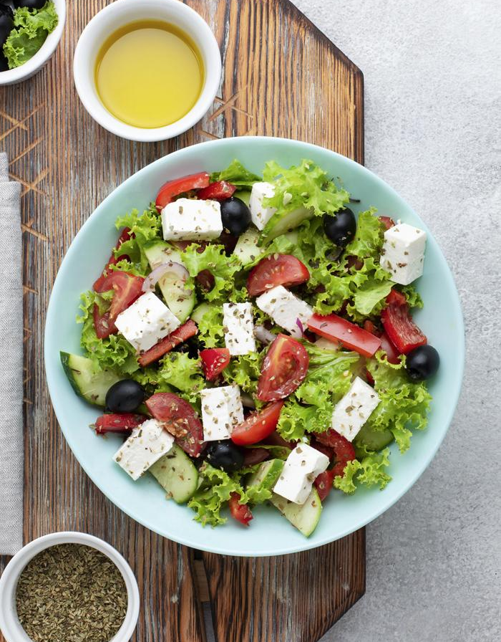
Calorie Counter?
Calorie Counter is a web-application that tracks for user consumed calories. User inputs for their BMI(Body Mass Index) values and then the meals or food items they have consumed during the course of the day and Calorie Counter averages the calories required by the body using BMI values. The counter also display for proteins,fats and carbohydrates intake along with the calories consumed by a user.

Slide 5

Goal…
The goal of the project is to put in place new solutions for all the fit freaks along with the people suffering from diseases or who wants to keep a check on their diet as per the end user expectations, so that the accuracy speedup and digitalization of the system will be enhanced.
It provide an efficient system for keeping a check on Health and calorie consumption and provide a simpler interface which is easy to operate on.
Since health is one of major concern in everyone’s life, and people these days relies more on technologies available to them such as pulse checker, my project aims to serve the purpose. It would help an individual to make a proper decision on food intake. It might serve as a warning to an individual too and he might not consume it thereby preventing any kind of mishap.

Slide 6

BMI(Body Mass Index)
Body Mass Index (BMI) is a measurement of a person’s weight with respect to his or her height. BMI, correlates with total body fat. This means that as the BMI score increases, so does a person’s total body fat. BMI is an indicator of total body fat in many individuals. Thus it is considered as an indicator of health risk.

Slide 7

Implementation Details:
Backend Coding : Python and Django
Database : DB-SQLite
Frontend : HTML,CSS
Softwares used :Visual Studio (Django Code), Brackets(HTML Code) , Google Chrome (127.0.0.1:8000)
OS used : Windows-10 (64 bit) created virtual environment for code (Django requirement) and browser to run upon.

Slide 8

Structure of Project

Slide 9
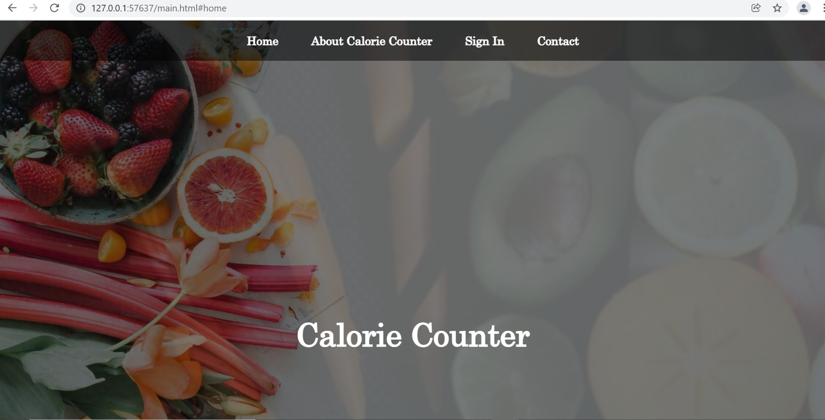
Home Page
The above image is a display of Home page of Calorie Counter application. That is this is the initial display to a user. It consist of 4 buttons on the top one for itself i.e. Home page. Next button is About Calorie Counter which gives the basic description about website to a user. Another button is for Sign-in where an interested user register or authenticate itself then Last button is for Contact , if in case any user have any queries or issues regarding application can contact.

Slide 10
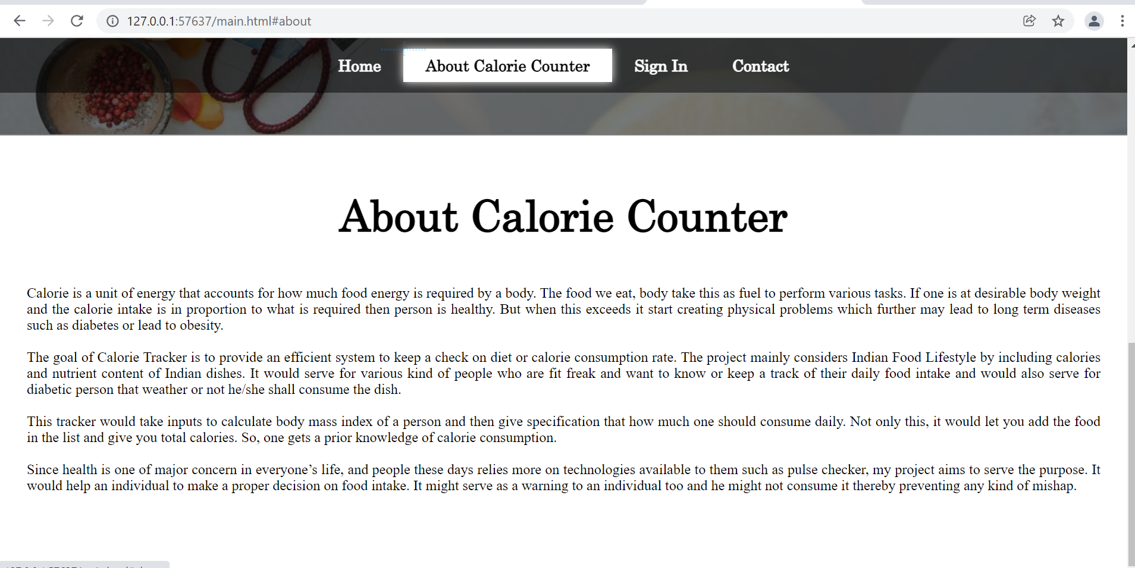
About Calorie Counter
The above image is a display of section About Calorie Counter. This gives a user basic idea about the application and why it can be useful to them. It’s a brief description of application to a user. If user find it any useful he/she can register themselves with the Sign-In option.

Slide 11
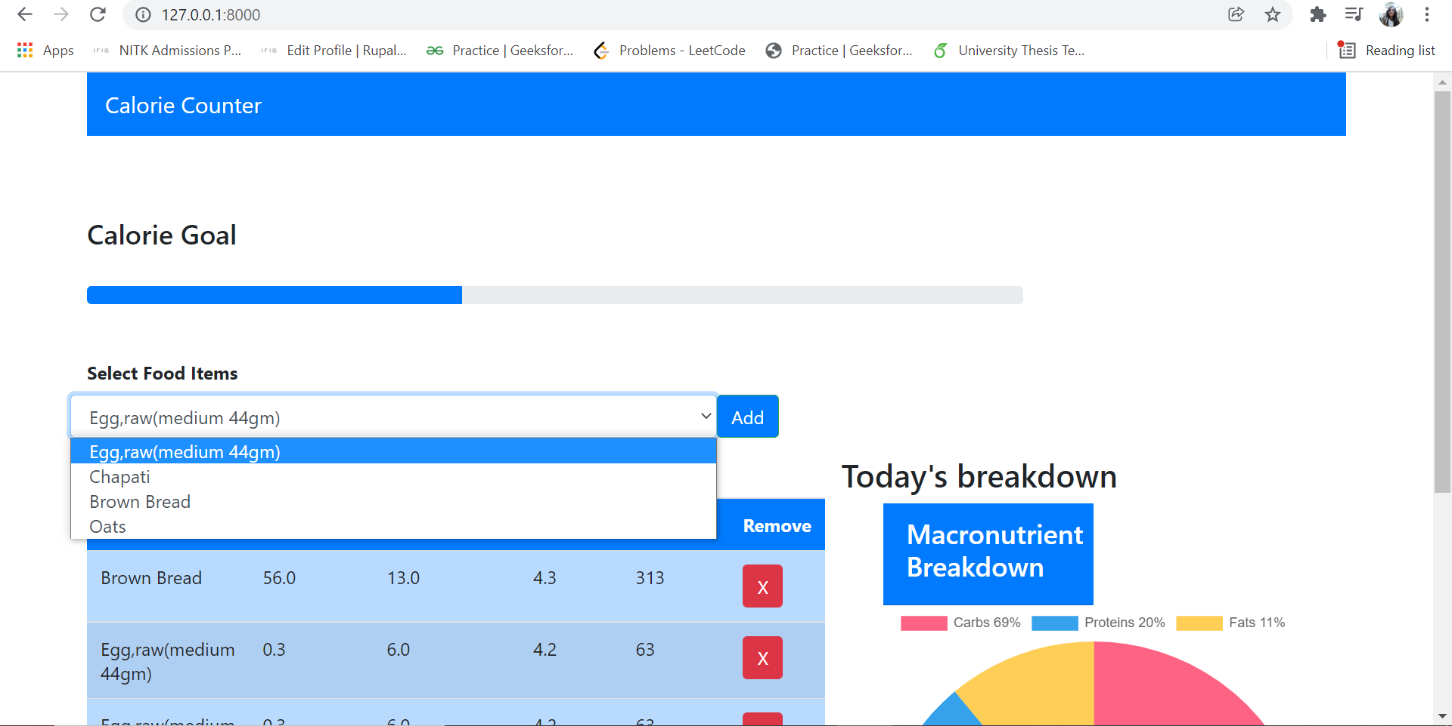
Add Items
When a user is registered and Sign-in the application he gets a drop down menu of selecting the items ,from where it can select the item that he is upto consuming and then press the Add button, this would add the item in his daily food consumption list.

Slide 12
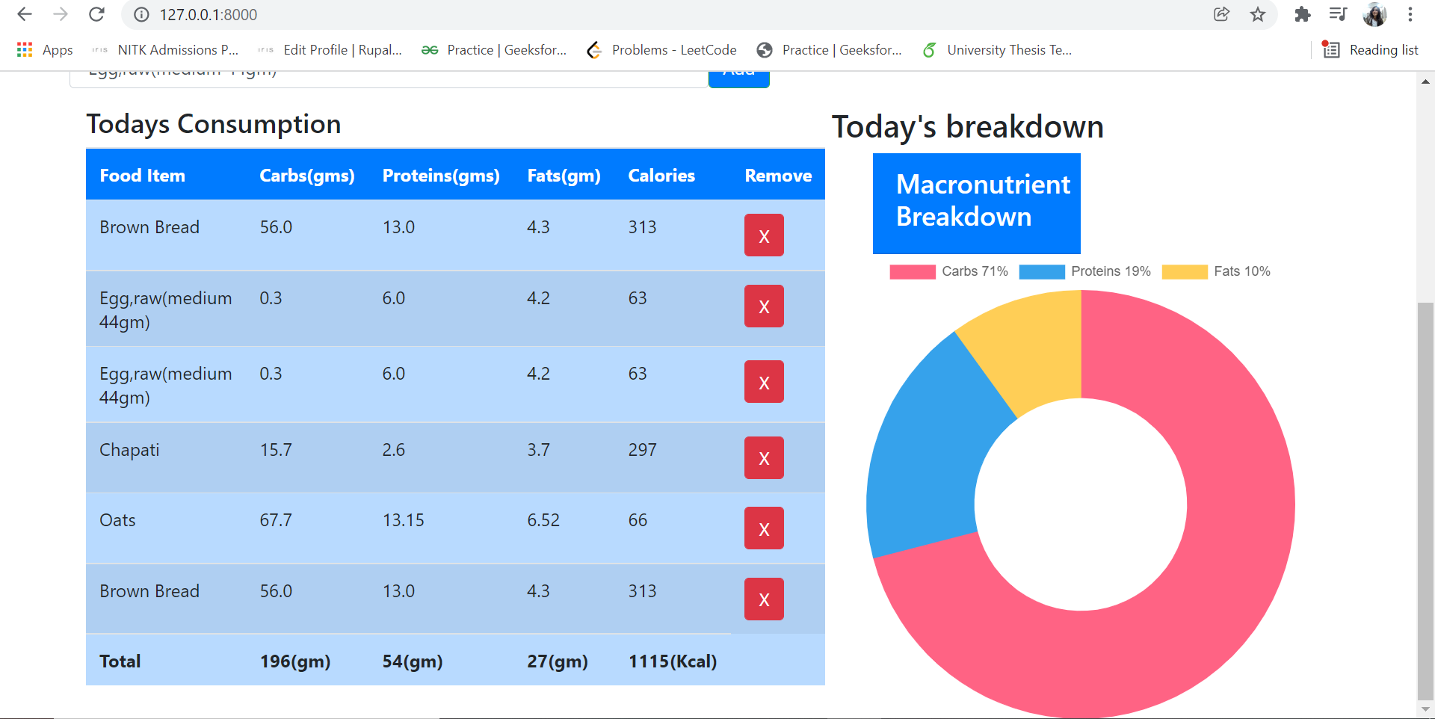
Total Calorie Consumption
When a user enters the item into the list, it updates. And user gets not only the total calories but a total of other macronutrients. A doughnut pie-Chart beside indicates the macronutrients consumed during the course of the day.

Slide 13
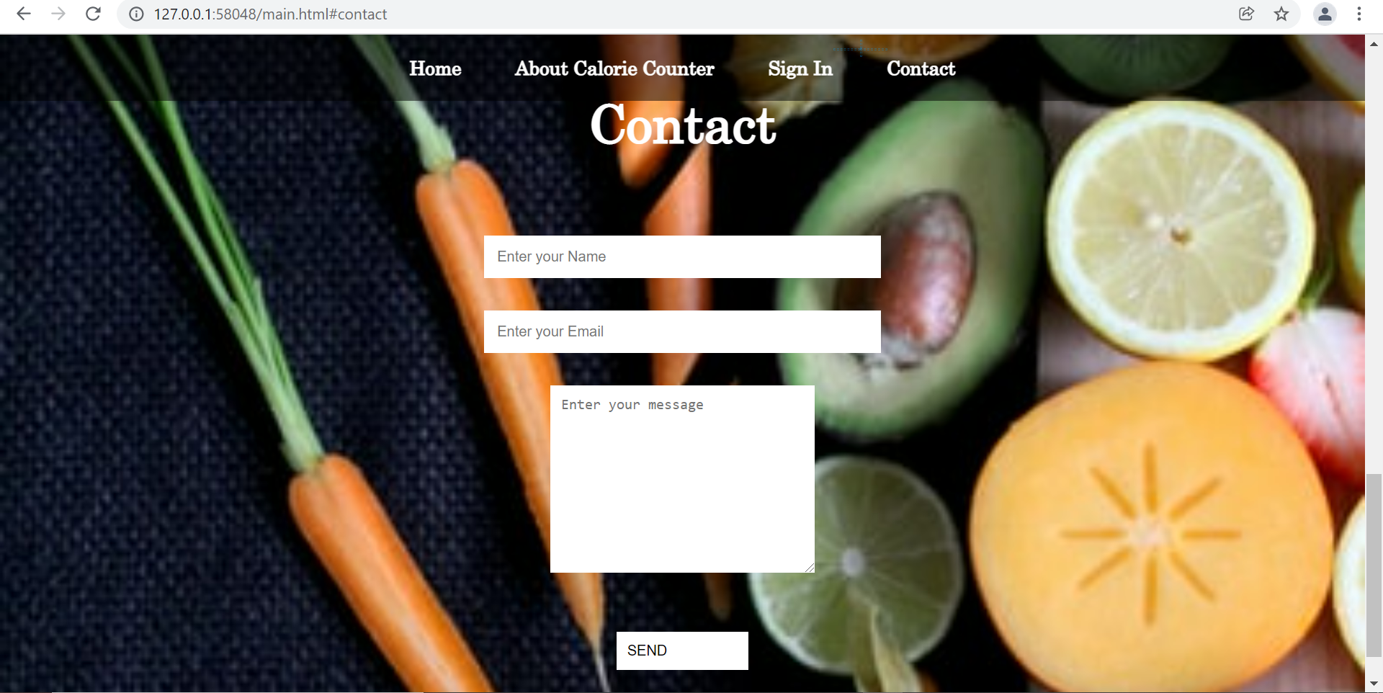
Contact
If any user have queries or facing any issue can contact the administrator and might get a bug or solution fixed.

Slide 14
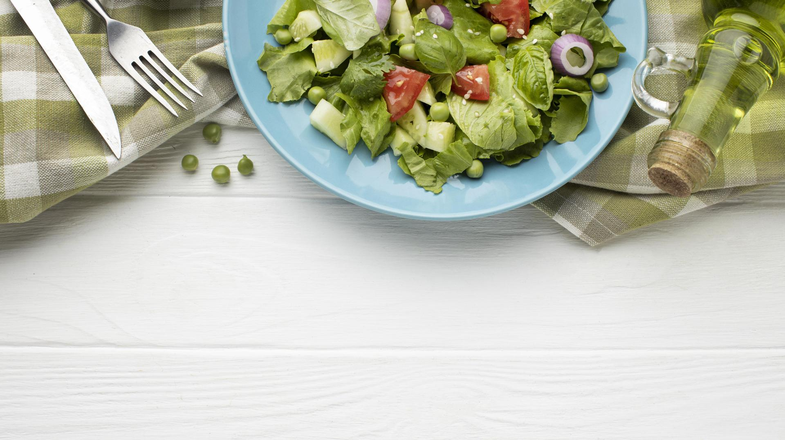
Future Works
Since the project have been implemented to facilitate users to maintain a healthy diet so once if they start using it and applying to their lives, I’d extend the basic model of my project to a new model. This would consist of maintaining their food charts monthly, yearly and so on. Also using AI I’d make prediction algorithm (doing research ) by judging how much one should consume and make diet charts for them according to their present health.
Also extend application to make special diet charts for people suffering from various diseases such as Diabetes , Cancer or Heart problems.
This basic model aims to create awareness among people about their diet that what they are intaking and what they shall include or replace with. I hope that the project would help users maintain their diet and serves it’s purpose.

Slide 15

Conclusion
A truly said word by Lao Tzu that “A journey of a thousand miles begins with a single step.” Everyone who ever lost weight or “got in shape” started on a single day. That day turned into a second day, a week, a month, and eventually a year. It didn’t happen overnight and it wasn’t always (or maybe ever) easy. But, persistence pays off when it comes to health. And, starting with a single step today—a short walk, some fruit for dessert, or an extra glass of water (not soda)—can pay off and bring you closer to the healthy and fit body you’ve always hoped for. This project make users restrict the
quantity of food they’ll have reduced calorie. Once they start restricting with the quantity, soon they’ll also realize to completely eliminate a bad diet and instead choose for a
healthy diet over and over.

Slide 16

References…
https://www.w3schools.com/html/html_computercode_elements.asp
https://docs.djangoproject.com/en/4.0/intro/tutorial01/
https://www.w3schools.com/css/
https://visualstudio.microsoft.com/
https://www.youtube.com/watch?v=sccLfQ4_u10&list=PLbGui_ZYuhigchy8DTw4pX4duTTpvqlh6

Slide 17

Thanks!
Do you have any questions?
rupalneema212is025@nitk.edu.in
Rupal Neema

